Slide 1
Dose Constraints in Radiation Oncology
Arya Amini
April 18, 2021

Slide 2
Overview
Palliative vs Definitive
When it doubt, fractionate
Review your OAR contours; when to consider PRVs; when to crop your OARs?
Dose painting – why heat up the center?
Talking with your dosimetrist – hard constraint vs soft constraint

Slide 3
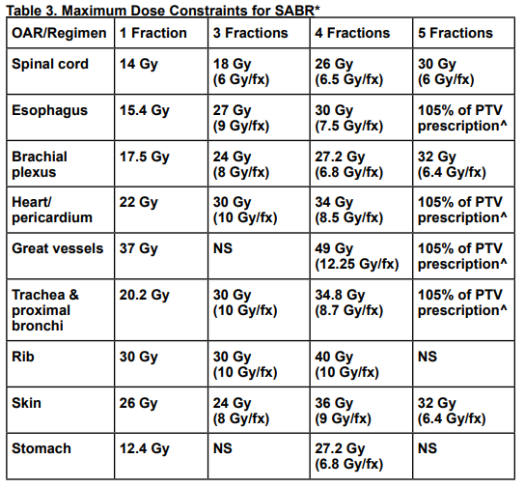
Palliative vs Definitive
Early stage NSCLC vs Oligometastatic disease to the lung
OAR | D0.03 cc
Esophagus | 35 Gy
Heart | 38 Gy
Great vessels | 53 Gy
Rib | 57 Gy
Trachea/bronchi | 40 Gy
NRG LU-002
NCCN Guidelines

Slide 4
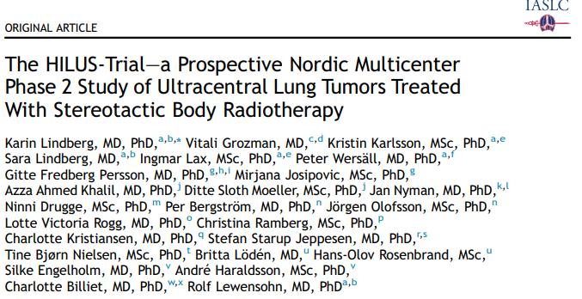
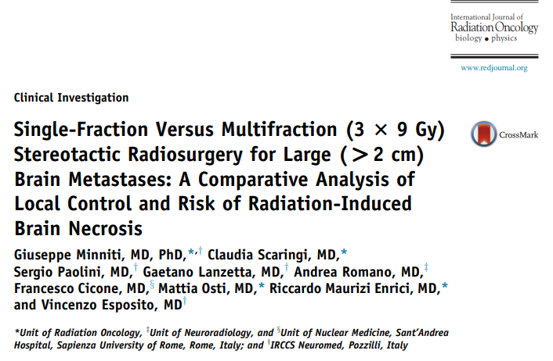
When in Doubt Fractionate

Slide 5
When In Doubt Fractionate
Peripheral, central, ultracentral lung primaries
54/3, 50-60/5, 60/8, 70/10, 45-60/15 fractions
Stage I NSCLC vs oligometastatic
Brain SRS: 1-5 fractions
Oligometastatic disease: 1-10 fractions

Slide 6
Lung SBRT
Common Constraints
V20 < 10%
MLD < 10 Gy
CW V30 < 30 cc (just make sure you know this is 3 fraction)
3 and 5 fraction constraints are main ones for boards
Don’t worry about 34/1 or 48/4

Slide 7
SBRT 3 Fraction Constraints
SBRT 5 Fraction Constraint (per NCCN and 0813)
Spinal cord – 18 Gy (6 Gy)
Brachial plexus – 24 Gy (8 Gy)
Skin – 24 Gy (8 Gy)
Esophagus – 27 Gy (9 Gy)
Heart – 30 Gy (10 Gy)
Airways – 30 Gy (10 Gy)
Great vessels 45 Gy (15 Gy)
Spinal cord – 30 Gy (6 Gy)
Brachial plexus – 32 Gy (~6 Gy)
Skin – 32 Gy (~6 Gy)
Esophagus – 35 Gy (7 Gy)
Heart – 105% prescription
Great vessel – 105% prescription
Airways max 105% prescription

Slide 8
Lung Conventional Fractionation
Lung V20 < 35% (accept <37%)
Esophagus mean < 34 Gy (keep circumference getting 60 Gy)
Heart V30 < 50% (classic); mean < 10 Gy (goal) but shoot for under 20 Gy (newer constraint)
Spinal cord max < 45 Gy
How high would you accept?
Brachial plexus max 66 Gy
For small cell, cord < 36 Gy (Turrisi), up to 42 Gy (CONVERT)

Slide 9
Sarcoma
Weight bearing bone V50 Gy < 50% (not hard constraint)
Circumferential sparing: spare 3 cm 30 Gy

Slide 10
Upper GI (esophagus/stomach)
Lung V20 < 20%; V5 < 65%
Heart V30 < 25%; mean < 25 Gy
Liver mean < 25 Gy (max < 30 Gy)
Kidney combined V18 < 33%
Bowel bag V45 < 200 cc

Slide 11
Lower GI (pancreas/rectum)
Lung V20 < 20%; V5 < 65%
Heart V30 < 25%; mean < 25 Gy
Liver mean < 25 Gy (max < 30 Gy)
Kidney combined V18 < 33%
Bowel bag V45 < 200 cc
Bladder V40 < 40%
Femoral head V40 < 40%; Dmax < 50 Gy
IT’S THE SAME!

Slide 12
Anal Cancer
Slightly different constraints
Small bowel V45 < 20 cc (not usual 195-200 cc)
Vulva/penis: V20 < 50%

Slide 13
Prostate
Conventional
Hypofractionation
Penile bulb V50 < 50
Rectum V65 < 35%
Bladder V65 < 50%; V60 < 40%
Femoral head Dmax 50 Gy
Bowel V45 < 195 cc
Bowel Dmax < 45 Gy
Rectum V60 < 20%
Bladder V60 < 20%
Adjuvant/Postop
Rectum V65 < 35%
Bladder V65 < 50%

Slide 14
GYN
Bowel V45 < 195 cc
Rectum V30 < 60%
Bladder V45 < 35%
Femoral neck V30 < 15 % (or same max at 50 Gy)

Slide 15
Breast
Ipsilateral lung V20 < 30%
Heart mean < 4 Gy

Slide 16
H&N
Standard
Ipsilateral Neck
Parotids mean < 26 Gy
Submandibular mean < 26 Gy (<39 Gy)
Oral cavity mean < 30 Gy
Larynx mean < 45 Gy (aim < 35 Gy)
Constrictor mean < 55 Gy
Cochlea max/mean 45 Gy
Esophagus mean < 34 Gy
Contralateral parotid mean < 8 Gy
Contralateral SM gland mean < 10 Gy
Oral cavity mean < 15 Gy
Larynx mean < 20 Gy

Slide 17
Primary CNS
Spinal cord max < 50 Gy
Brainstem max < 54 Gy (but you would be okay D0.03 cc 60 Gy)
Optic chiasm and nerves max < 54 Gy
QUANTEC allows for max < 60 Gy
Cochlea mean < 45 Gy
Hippocampus max <= 16 Gy (NRG CC001); D100: 9 Gy

Slide 18
SRS Constraints
Single Fraction
Three Fraction
Brain V12 < 10 cc
Optic pathway max < 8 Gy (can do up to 12 Gy)
Brainstem max < 15 Gy
Cochlea max < 9 Gy
Brain V18 < 26 cc
Brain V21 < 21 cc
Brain V24 < 16.8 cc
Brain V20 < 20 (easy one – HyTEC)
Optic pathway max < 17 Gy
Brainstem max < 23 Gy

Slide 19
Lymphoma
Same constraints that you have for all other sites – generally easy to meet since dose for lymphoma is much lower

Slide 20
Pediatrics
These are tough and often treated per protocol
I don’t recall getting asked constraints
Know how to plan CSI and know treatments for each
Otherwise similar constraints to adults

Slide 21
Pediatrics
Wilms/Neuroblastoma
Contralat whole kidney < 14.4 Gy; whole liver < 23.4 Gy
CNS
Optic chiasm/nerves < 54 Gy
Cord max 50/50.4 Gy
Brainstem max 60 Gy

Slide 22
Questions

